Slide 1
Introduction to Query Builder

Slide 2
Query Builder Features
  Easy-to-use data access tool
  Point-and-click graphical user interface
  Distributed data access
  Powerful query building
Notes:
Lesson Aim
This lesson teaches you more about using Query Builder, the tool used in the LOV wizard to build the query on which a record group is based.
What Is Query Builder?
Easy-to-Use Data Access Tool
Query Builder is an easy-to-use data access tool. It provides a logical and intuitive means to access information stored in networked, distributed databases for analysis and reporting.
Point-and-Click Graphical User Interface
Query Builder enables you to become productive quickly because its graphical user interface works like your other applications. A toolbar enables you to perform common operations quickly.
Distributed Data Access
Query Builder represents all database objects (tables, views, and so on) as graphical datasources, which look and work exactly the same way regardless of which database or account the data came from.

Slide 3
Query Builder Features
  Easy-to-use data access tool
  Point-and-click graphical user interface
  Distributed data access
  Powerful query building
Notes:
What Is Query Builder? (continued)
Performing distributed queries on complex, enterprisewide databases is no more difficult than querying a single database.
Locating database objects is easy because Query Builder uses a single hierarchical directory that lists all accessible data in your account, in other accounts, and in other databases.
Powerful Query Building
Query Builder is designed for professionals who do not have a computer programming or database background. However, because of its powerful query features and its support of Structured Query Language (SQL) statements, experienced database users and programmers will find that Query Builder serves many of their needs as well.
Graphical representation of tables and their relationships enables you to see the structure of your data.
You can build queries by clicking the columns that you want to retrieve from the database. The browser generates the necessary SQL statements behind the scenes.
You can specify exactly which rows to retrieve from the database by using conditions, which consist of any valid SQL expression that evaluates to true or false.
You can combine and nest conditions graphically using logical operators. You can disable conditions temporarily for what-if analysis.

Slide 4
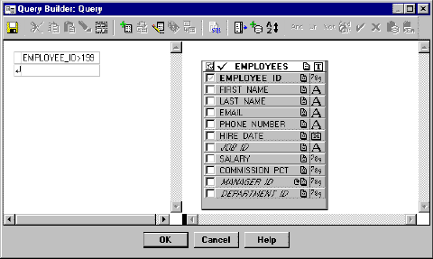
Query Builder Window
1
2
3
Notes:
The Query Builder Window
The Query Builder graphical user interface consists of one window, the Query window, where you build your queries.
The Query Builder window is comprised of:
1. The Toolbar that enables you to issue commands with a click of the mouse. You can create conditions, add new datasources, or define new columns.
2. The Conditions panel where you specify conditions to refine your queries
3. The Datasource panel where you display and select tables and columns for a query

Slide 5
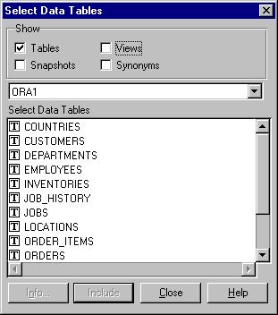
Building a New Query
Notes:
Building a New Query
To build a query, you must select the tables you want to include and the columns you want to retrieve.
How to Include a Table
1. Choose Select Data Tables from the toolbar.
The Select Data Tables dialog box appears.
Note: When you open Query Builder to create a new query, the Select Data Tables dialog box is open by default.
2. Select the table name and then click Include, or simply double-click the desired table name.
The selected table appears in the Query window.
3. Click Close to close the dialog box.
You can at any time include additional tables in the query by following these steps.
How to Delete a Table
1. Select the data source in the Query window.
2. Select Clear from the toolbar or press [Delete].

Slide 6
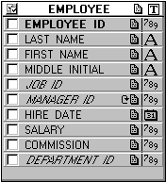
Datasource Components
Datasource
name
Object
type
Primary Key
Column
datatype
Column name
Recursive
relationship
Foreign Key
Comment
Notes:
Datasource Components
Datasource name
An object that has been included in a query is referred to as a datasource. It is displayed as a rectangular graphic in the Datasource panel of the Query window. The top part of the rectangle contains the table name and an icon representing the object type:

Slide 7
Notes:
Datasource Components (continued)
Columns
The body of the rectangle contains column names listed vertically. To the right of the column name is an icon representing the datatype.
Columns also provide additional information.
Primary keys are displayed in bold.
Foreign keys are displayed in italics.
Recursive relationships are indicated by a self-relationship icon.
Comments
If the table or column is commented, an icon appears to indicate the presence of a comment. You can double-click the icon to read the comment.

Slide 8
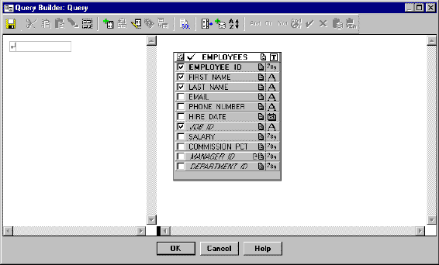
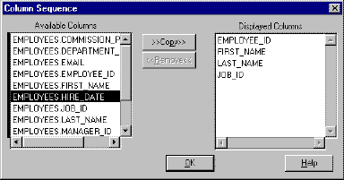
Refining a Query
Notes:
Refining a Query
Adding Columns to a Query
You can add a column to a query either by selecting the check box to the left of the column name, or by double-clicking the column name. To include all columns from any single table, double-click the table heading.
Removing Columns from a Query
You can remove columns from a query either by clearing the check box to the right of the column name, or by double-clicking the column name. To remove all columns from any single table, double-click the table heading.
Changing Column Position in a Query
By default, Query Builder places columns in the order in which you select them. You can resequence them by selecting the Column Sequence tool.
The Column Sequence dialog box appears. Column names are shown in the Displayed Columns list in order of their appearance in the query. Drag any column to a new position.
Note: You can also use the Column Sequence dialog box to add columns to or remove them from a query.

Slide 9
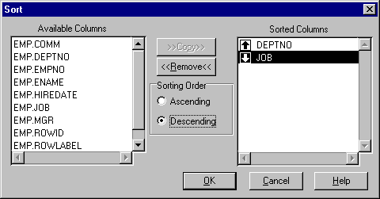
Sorting Data
Notes:
Sorting Data
By default, a query returns the data in no specific order. To sort the data, you must add an ORDER BY clause to the query.
How to Add an ORDER BY Clause to a Query
1. Select the Sort tool. The Sort dialog box appears.
2. Select the column you want to sort from the Available Columns list.
3. Select Copy.
Query Builder adds the column to the Sorted Columns list and places an up arrow in the list box to indicate the default sort ascending order.
Note: You can sort by more than one column. Query Builder sorts according to the order in which columns appear in the Sorted Columns list.
4. You can change the sorting order by selecting the column name in the Sorted Columns list and selecting the desired option button.
5. Select OK to close the dialog box.

Slide 10
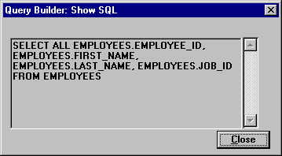
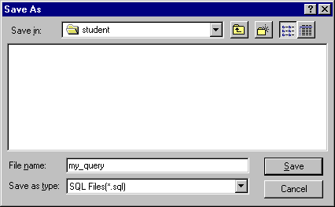
Viewing and Saving Queries
Notes:
Viewing and Saving Queries
Viewing a Query
Select the Show SQL tool to view the query text that Query Builder will create.
How to Save a Query
You can save your query as a SQL statement to the file system.
1. Select the Save tool from the toolbar.
The Save As dialog box appears.
2. Enter a filename.
Note: If you do not enter a file extension, Query Builder automatically appends the .SQL file extension.
3. Select a destination.
4. Click OK.

Slide 11
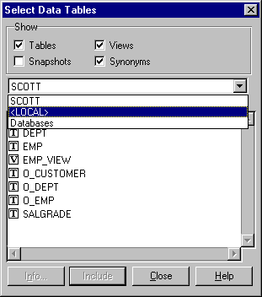
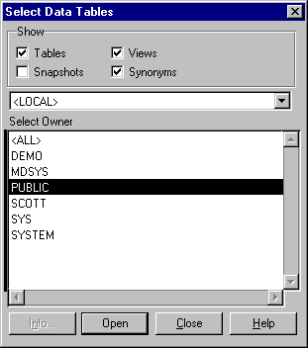
Including Additional Tables
Notes:
Including Additional Tables
Often, all of the data needed to create a desired report cannot be found in a single table. With Query Builder, you can include multiple tables in a single query.
Remember that you can see the names of all the tables in your schema by choosing the Select Data Tables tool. This brings up the Select Data Tables dialog box. You can also use this dialog box to show only certain types of datasources as well as datasources in other schemas and databases.
How to Find Tables in Other Schemas
If you do not find the table you are looking for in the Select Data Tables dialog box in your own schema, you can search other schemas.
1. Open the pop-up menu to display the name of the current database and the option databases.
2. Select the current database name.
The list box displays a list of schemas that contain tables you can access.
3. Select the name of the schema in the list and then click Open, or simply double-click the schema name. This opens the schema and displays a list of objects in the schema.
4. Follow the normal procedure for including objects in the Query window.

Slide 12
Including Additional Tables
Notes:
Including Additional Tables (continued)
How to Find Tables in Other Databases
If you do not find the table you are looking for in the Select Data Tables dialog box in your own schema, you can search other databases.
1. Open the pop-up menu to display the name of the current database and the option databases.
2. Select databases.
The list box displays a list of databases you can access.
3. Select the name of the database in the list and then click Open, or simply double-click the account name.
4. Follow the normal procedure for including tables in the Query window.

Slide 13
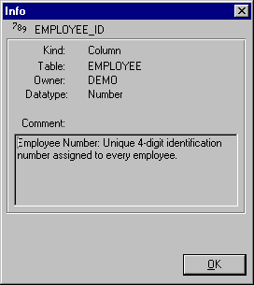
Viewing Comments
Notes:
How to View Comments
Sometimes, details about the kind of data stored in the database are not reflected by the table or column names. This can often make it difficult to decide which objects to include in your query. Query Builder features the Get Info dialog box to provide this kind of information for tables and columns.
To open the dialog box, follow these steps:
1. In the Datasource panel, select the table or column name.
2. Select the Get Info tool.
Alternatively, you can double-click the Comment icon in each table or column in the Datasources panel.

Slide 14
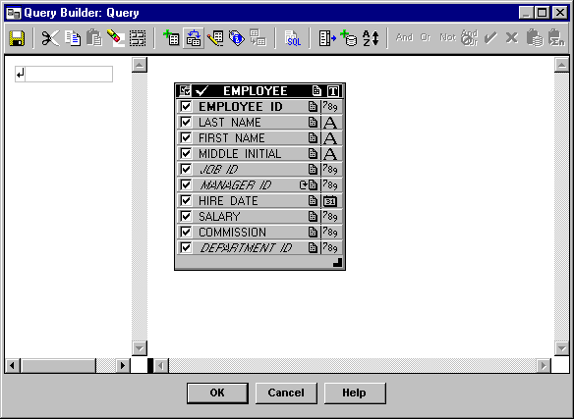
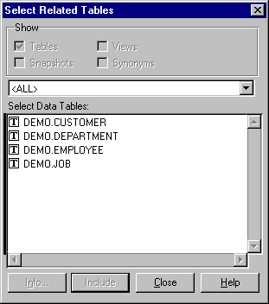
Including Related Tables
Notes:
Relationships
To combine data from multiple tables into one query, Query Builder enables you to search for relationships between tables and to create user-defined relationships if they do not exist. Additionally, you can activate or deactivate relationships to suit your needs.
How to Find and Include Related Tables
1. Select the table in the Datasource panel.
2. Choose the Select Related Tables tool.
A list of tables that have relationships defined with the selected table appears.
3. Select the table name and click Include, or simply double-click the table name.
The selected table appears in the Datasource panel. Relationships between the tables are identified by relationship lines, drawn from the primary keys in one table to the foreign keys in another.
4. Click Close to close the dialog box.
Once you have included the table, you can retrieve its columns.
Note: When you select a foreign key column before selecting related tables, only the table to which the foreign key refers appears in the Select Related Tables dialog box.

Slide 15
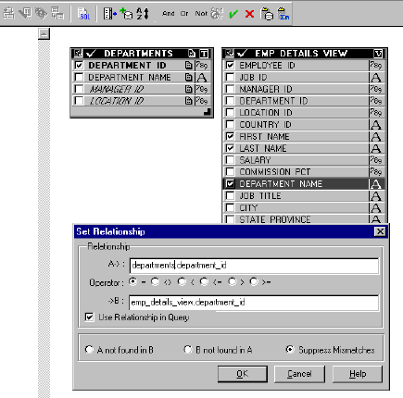
Creating a User-Defined Relationship
Notes:
Creating a User-Defined Relationship
When you create a user-defined relationship, Query Builder draws a relationship line connecting the related columns.
How to Create a Relationship
1. Select the Set Table Relationship tool.
The Set Relationship dialog box appears.
2. Enter the foreign key (A >) and primary key (B >) column names.
3. Type the complete table and column names (separate the table name from its column name with a period).
4. Click OK to close the dialog box.
How to Create a Relationship (Optional Method)
1. Select the column that you want to relate (foreign key).
2. Press and hold the mouse button, and drag the cursor to the related column in the second table (the primary key).
You are drawing a relationship line as you do so.
3. Once the target column is selected, release the mouse button to anchor the relationship line.

Slide 16
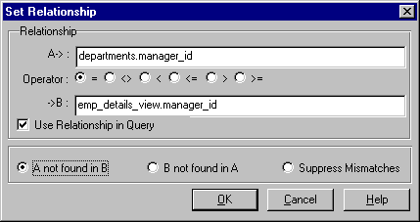
Unmatched Rows
Notes:
Retrieving Unmatched Rows
Query Builder enables you to choose whether to retrieve any unmatched rows when you are using a relationship in a query. An unmatched row occurs when the relationship connects tables where there are values on one side that have no corresponding values on the other side.
There are three types of relationships that you can choose from:
Display records from table A not found in table B
Display records from table B not found in table A
Suppress any mismatched records (default)
How to Create an Unmatched Relationship
1. Click on the relationship line that connects the tables.
Both the column names and the relationship line should be selected.
2. Select the Set Table Relationship tool from the toolbar.
The Set Relationship dialog box appears.
3. Choose one of the three relationship option buttons.
4. Click OK.
An unmatched relationship icon is placed on the relationship line next to the column that returns unmatched rows.

Slide 17
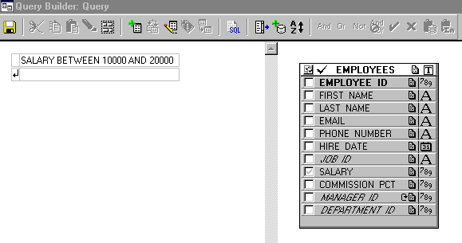
Conditions
Notes:
Selecting Rows with Conditions
The Conditions Panel
The Query window contains two independently scrollable panels, the Conditions panel and the Datasource panel. The Datasource panel is where you include tables and columns. The Conditions panel is where you apply conditions. You enter conditions into the Condition field of the panel.
How to Add Conditions to a Query
1. Activate the Conditions field.
2. Enter the text that describes the condition in one of the following ways:
Type the conditions directly into the Condition field
Click in the columns in the Datasource panel and enter the rest of the condition
Select columns and functions, using the appropriate tools.
Note: Character and date values must be enclosed in single quotes.

Slide 18
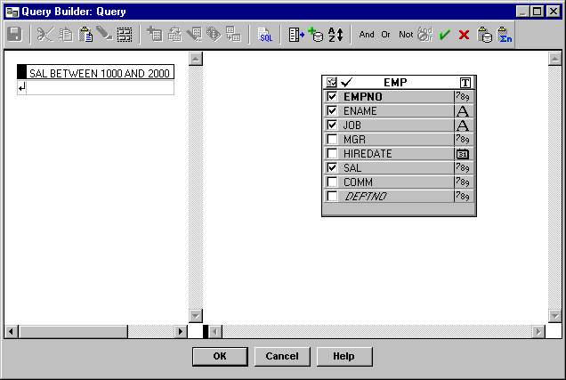
Conditions
Notes:
Selecting Rows with Conditions (continued)
3. Closing and Validating the Condition: Query Builder automatically validates the condition when you close the Condition field. You can close the Condition field in the following ways:
Press [Return].
Click in the Conditions panel outside the Condition field.
Select Accept from the toolbar.
Note: If a column is used in a condition but it is not displayed in the results window, a gray check mark appears to the left of the column name in the datasource in the Query Window.
The Toolbar
The logical operators and the Accept and Cancel tools in the toolbar are active whenever the Condition field is active. You can insert an operator from the toolbar into the condition by clicking it.

Slide 19
Operators
Arithmetic
  Perform calculations on numeric and date columns
  Examples: +, -, x, /
Logical
  Combine conditions
  Examples: AND, OR, NOT
Comparison
  Compare one expression with another
  Examples: =, <>, <, IN, IS NULL,
  BETWEEN ... AND
Notes:
Operators
An operator is a character or reserved word that is used to perform some operation in Query Builder, such as the + operator, which performs addition. Query Builder uses several types of operators.
Arithmetic Operators
Arithmetic (+, -, x, /) operators are used to perform calculations on numeric and date columns. In handling calculations, Query Builder first evaluates any multiplication or division, and then evaluates any addition or subtraction.
Logical Operators
Logical operators are used to combine conditions. They include:
AND: Causes the browser to retrieve only data that meets all conditions
OR: Causes the browser to retrieve all data that meets at least one of the conditions
NOT: Used to make a negative condition, such as NOT NULL
Comparison Operators
Comparison operators are used to compare one expression with another, such that the result will either be true or false. The browser returns all data for which the result evaluates true.

Slide 20
Operators
Arithmetic
  Perform calculations on numeric and date columns
  Examples: +, -, x, /
Logical
  Combine conditions
  Examples: AND, OR, NOT
Comparison
  Compare one expression with another
  Examples: =, <>, <, IN, IS NULL,
  BETWEEN ... AND
Notes:
Operators (continued)

Slide 21


Multiple Conditions
Notes:
Entering Multiple Conditions
There is no limit to the number of conditions you can include in a browser query. Multiple conditions are always combined using logical operators. You can add conditions to any query either before or after execution.
How to Add Conditions
The Conditions panel always displays a blank Condition field at the bottom of the list of conditions. Use this field to enter multiple conditions.
1. Click in the empty Condition field to activate it.
2. Enter the new condition.
Each time you add a condition, a new blank Condition field is created.
Note: Pressing [Shift]-[Return] following the entry of each condition is the fastest way to create multiple conditions, because it moves the cursor and prompt down one line so that you can enter another condition.
3. Press [Return] to close and validate the condition.
How to Change Logical Operators
By default, Query Builder combines multiple conditions with the AND operator. To change the logical operator:

Slide 22
Multiple Conditions
Notes:
Entering Multiple Conditions (continued)
1. Select the logical operator in the Conditions panel.
2. Click a new operator on the toolbar or select one from the Data menu.
How to Create Nested Conditions
Query Builder enables you to combine logical operators to produce complex queries made up of multiple levels of conditions. These are referred to as nested conditions. To nest two or more conditions:
1. Build each condition to be included in the nest.
2. While you press and hold [Shift], click in the box to the left of each condition to be nested.
3. Select the logical operator to combine the conditions—either AND or OR.
Query Builder draws a box around the highlighted conditions in the Conditions panel and combines them with the operator that you specified.

Slide 23

Deactivating a Condition
Notes:
Changing Conditions
If you change your mind about including one or more conditions in your query, you can delete, deactivate, or edit any of them in the Conditions panel.
How to Delete a Condition
1. Click inside the Condition field to activate it.
2. Select Clear from the toolbar or select Delete.
The condition is removed from the query.
How to Deactivate a Condition
Query Builder enables you to temporarily deactivate a condition so that you can test different scenarios without having to re-create the conditions each time.
Double-clicking the box to the left of the condition or its operator acts as a toggle switch, alternately turning the condition on and off. Deactivated conditions remain in the Condition field but appear dimmed.
Additionally, you can turn conditions on and off by using the Data menu:
1. Select the box to the left of the condition or its operator.
Note: Hold down the [Shift] key to select multiple conditions.
2. Double-click in the box to deactivate the condition.

Slide 24
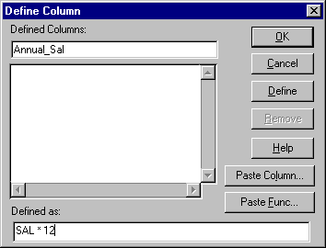
Defining Columns Using an Expression
Notes:
Defining Columns Using an Expression
Besides retrieving columns of data stored in a table, Query Builder enables you to define new columns that are derived or calculated from the values in another column.
How to Define a Column
When you define a column, it exists only in your query, not in the database.
1. Select the table where you want to define a new column.
2. Select the Define Column tool.
The Defined Column dialog box appears, which displays a list of all columns currently defined in the query (if any).
3. Click in the Defined Column field to activate it, and then enter the name for your new column.
4. Move your cursor to the Defined As field and enter the formula or expression that defines your column.
5. Select Define.
The new column is added to the list of defined columns in the dialog box and appears in the Datasource panel.
6. Click OK to close the dialog box.

Slide 25
Defining Columns Using an Expression
Notes:
Defining Columns Using an Expression (continued)
How to Enter Expressions
You can enter information in the Defined As field in the following ways:
Type the expression in directly.
Select Paste Column.
The Paste Column dialog box appears.
Select the column from the displayed list.
Click OK to paste the column into your expression and return to the Define Column dialog box.
How to Display and Hide Defined Columns
You display or hide defined columns from a query in exactly the same manner as you do ordinary columns.

Slide 26
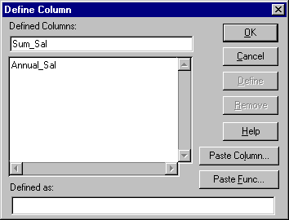
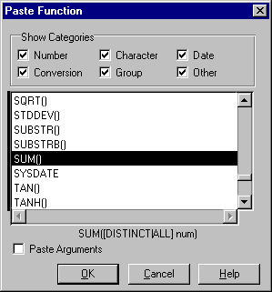
Defining Columns Using a Function
Notes:
Defining Columns Using a Function
The browser also enables you to define columns using a variety of built-in functions provided by the Oracle Server. You can type a function directly in the Defined As field of the Define Columns dialog box, or click Paste Function to select from a list.
What Is a Function?
A function is similar to an operator in that it performs a calculation and returns a result. Functions consist of a function name followed by parentheses, in which you indicate the arguments.
An argument is an expression that supplies information for the function to use. Functions usually include at least one argument, most commonly the name of the column on which the operation will be performed.
Single-Row Functions
Return one value for every data row operated on
Examples: INITCAP(), SUBSTR(), TRUNC()
Aggregate Functions
Return a single row based on the input of multiple rows of data
Examples: AVG(), COUNT(), SUM()

Slide 27
Defining Columns Using a Function
Notes:
Defining Columns Using a Function (continued)
How to Select a Function
1. Click in the Defined As field to activate it.
2. Select Paste Function.
The Paste Function dialog box appears.
3. Select or deselect the Show Categories check boxes to view the desired list of functions.
4. Select the function from the displayed list.
5. Select the Paste Arguments check box (optional).
Note: If this check box is selected, a description or datatype name of the arguments appropriate for the function is pasted into your expression. You then replace the description with the actual arguments.
6. Click OK to paste the function into your expression and return to the Define Columns dialog box.

